Slide 1

Computational Efficiency in Early Warning Systems for Financial Credit Risk.
8 Dec 2024
241-MATH-557-01(Applied Linear Algebra)
Course Project - Group C
Download Project Source Code
Khaleel Alhaboub, Mahdi Almayuf, and Hassan Alalwi

Slide 2

Background
An Early Warning System (EWS) identifies loan risks and financial distress early. It looks at past data, current financial status, economic conditions to predict which clients (company) may become risky in the future.
The system uses information like transaction histories, credit scores, and economic factors to help financial institutions manage risks.
As the data becomes bigger, the system needs better methods to work faster and stay reliable.

Slide 3

Objective
To enhance the computational efficiency of Early Warning Systems (EWS) in handling large datasets by addressing the performance bottleneck caused by matrix operations. This project will:
Identify and analyze the inefficiencies in the current naïve method.
Apply advanced matrix decomposition methods to optimize computational processes.
Develop a robust and scalable solution to ensure faster processing and improved system performance for large-scale data.

Slide 4
Problem Statement
The Early Warning System (EWS) in finance helps assess loan default risks by analyzing financial data. However, as data grows, scalability issues arise due to the computational complexity of key matrix operations:
Multiplying two matrices of input features (client financial data) requires n³ operations
Inverting a matrix, for large datasets, is expensive and has time complexity of O(n³)
IMPACT:
Longer processing times
Limiting real-time insights.
Inefficient resource use.
Addressing these challenges is crucial for scalable EWS performance.

Slide 5
Methodology
Data Generation
Baseline
Improved Function
Validation
Stress Testing
Performance Analysis
Refinement
Agile Techniques

Slide 6
Data and Simulation
We have generated large-scale synthetic dataset with 1,000,000 rows and 24 features to simulate real-world financial data.
Then we used the data in the benchmarking.
Field | Scale
Credit Score | 300-850
Debt-to-Income Ratio | 0.01-1.5
Liquidity Ratio | 0.01-1.5
Profitability Ratio | 0.01-1.5
Interest Rate | 0.1-1.5
Stock Market Index | 1-100
Currency Exchange Rate | 1-100
GDP Growth Rate | 0.1-1.5
Inflation Rate | 0.1-1.5
Annual Revenue | $0.01 - $1,000,000+
Gross Profit | $0.01 - $1,000,000+
Outstanding Loan Amount | $0.01- $500,000+
Loan-to-Value Ratio | 0.01 - 2+
Missed Payments | 0.01 - 12+
Operating Cash Flow | $0.01 - $1,000,000+
Employee Count | 1 - 10,000+
Inventory Turnover | 0 - 100+
Operational Expense | $0.01 - $500,000+
Market Share | 0.01% - 100%
Sales Growth | 0% to 200%+
Customer Churn Rate | 0.01% - 100%
Supplier Reliability | 0.01 - 100
Regulatory Compliance Score | 0.01 - 1000
R&D Spending | $0.01 - $100,000+
Delivery Time | 0.01 - 1000 days

Slide 7
Benchmarking Criteria
Metrics:
Execution Time (s)
CPU Time (s)
Memory Usage (MB)
We used Python profiling tools to measure improvements.

Slide 8
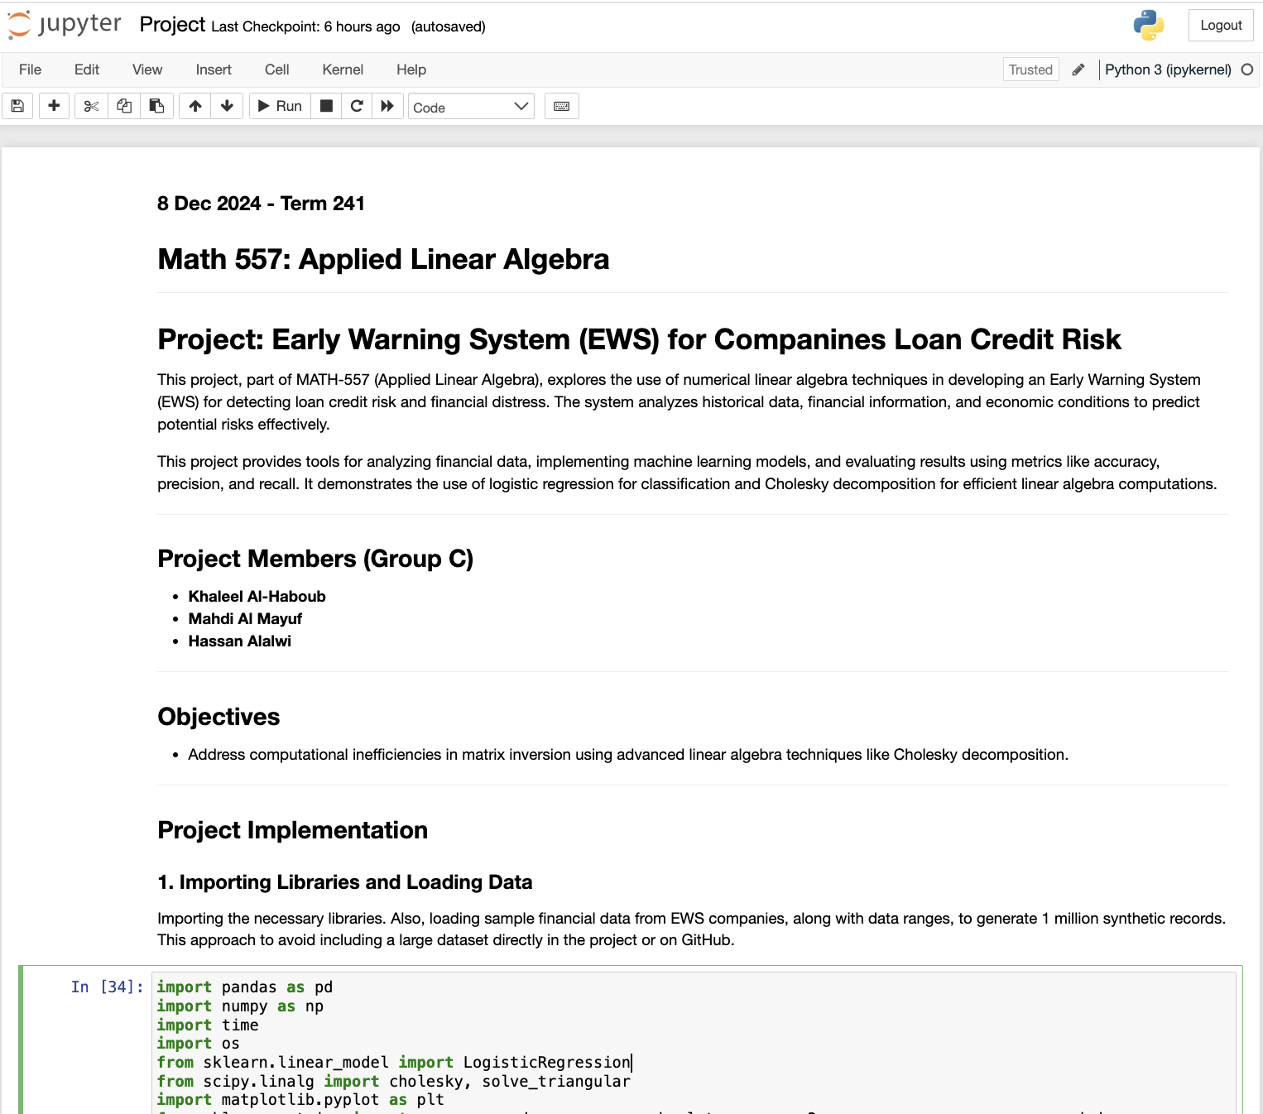
Project Implementation
Initially considered using Julia with Pluto, but we have encountered scalability issues.
We chose Python’s Jupyter for its interactivity, easy visualization, and strong libraries like NumPy and SciPy to handle large dataset.

Slide 9
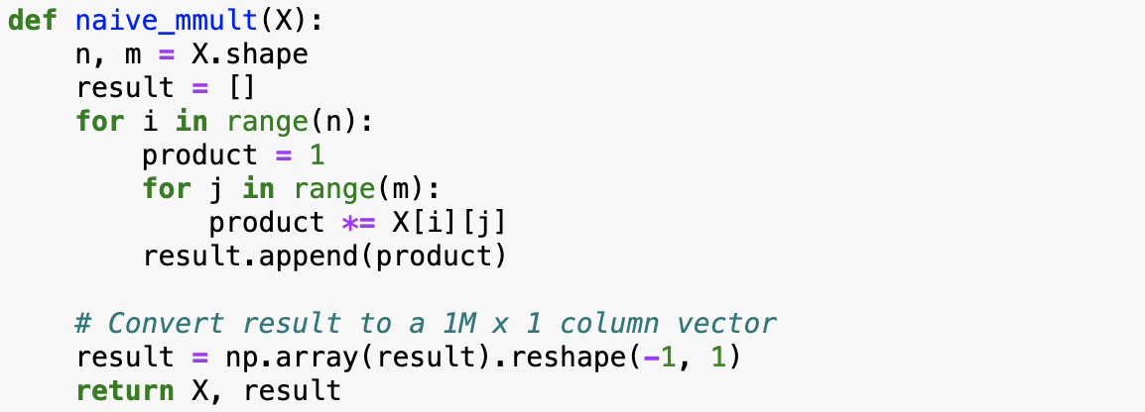
Baseline
We implemented a naïve approach for matrix multiplication using nested loops, as shown. However, this approach has to long execution times and high CPU usage due to its inefficiency in handling large datasets.

Slide 10
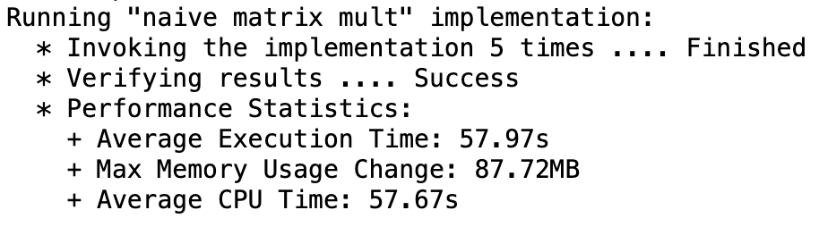
Baseline Results
Key Observations:
Poor scalability.
High memory consumption and processing times.
Limited ability to provide near real-time data
Effective for small datasets, but inefficient for large-scale system.

Slide 11
Improvements
Building on Baseline Results, we identified key bottlenecks in both speed and memory.
Adopted an agile approach, step-by-step testing, evaluate and implement various algorithms for matrix operations:
PCA (Principal Component Analysis)
SVD (Singular Value Decomposition)
Cholesky Decomposition

Slide 12
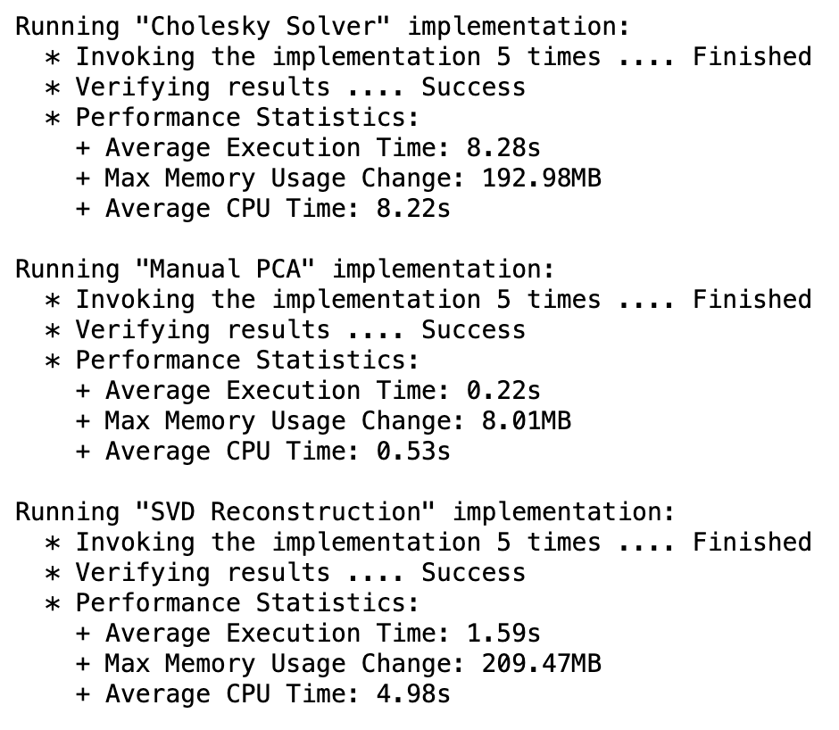
Improvements Results
Improved
Baceline

Slide 13
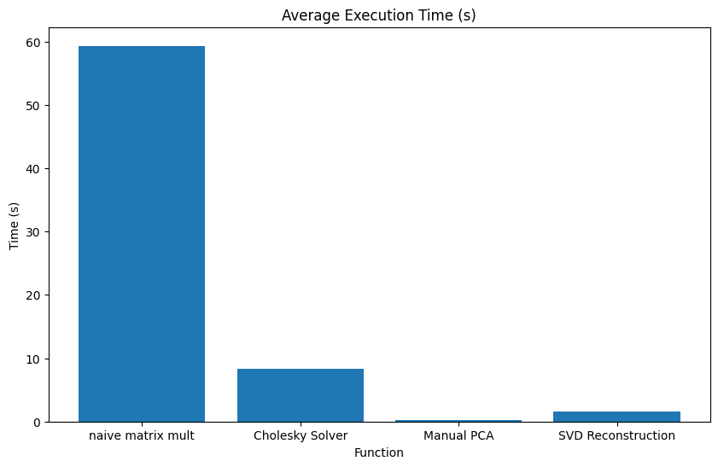
Performance Analysis Execution Time

Slide 14
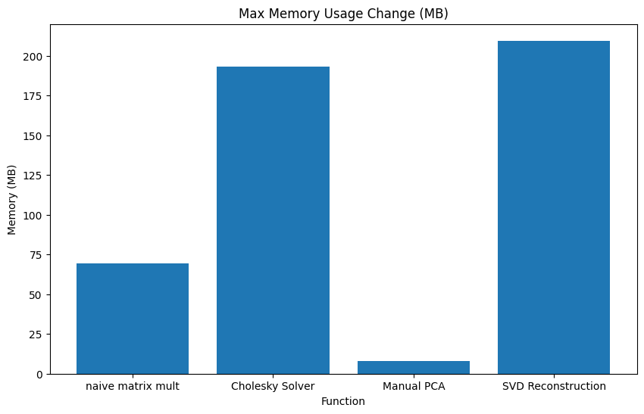
Performance Analysis Memory

Slide 15
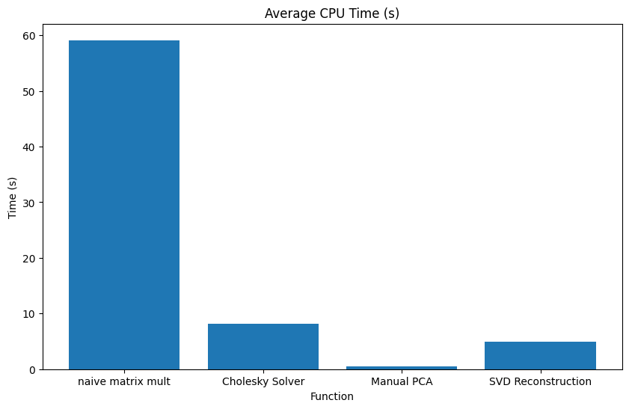
Performance Analysis CPU Time

Slide 16
Conclusion
We improved the speed and efficiency of matrix operations:
Cholesky: Significant speed improvement, ideal for time-sensitive tasks, needs more effort to overcome non-square and non-positive definite cases.
PCA: Efficient in both time and memory. It is suitable for lightweight operations.
SVD: Efficient in time, but high memory usage. It is suitable heavy operations where accuracy is a must.

Slide 17
Lessons Learned
Scalability needs proper planning, and methods suitable for small datasets may not be ideal to handle larger dataset efficiently.
Don’t unintimate optimization, so replacing naïve approaches, with like with optimized techniques like PCA decomposition drastically improves performance.
Always improve your approach, and regular performance testing is essential to identify and address bottlenecks effectively.

Slide 18
Q&A

Slide 19
Thank you!

